Slide 1
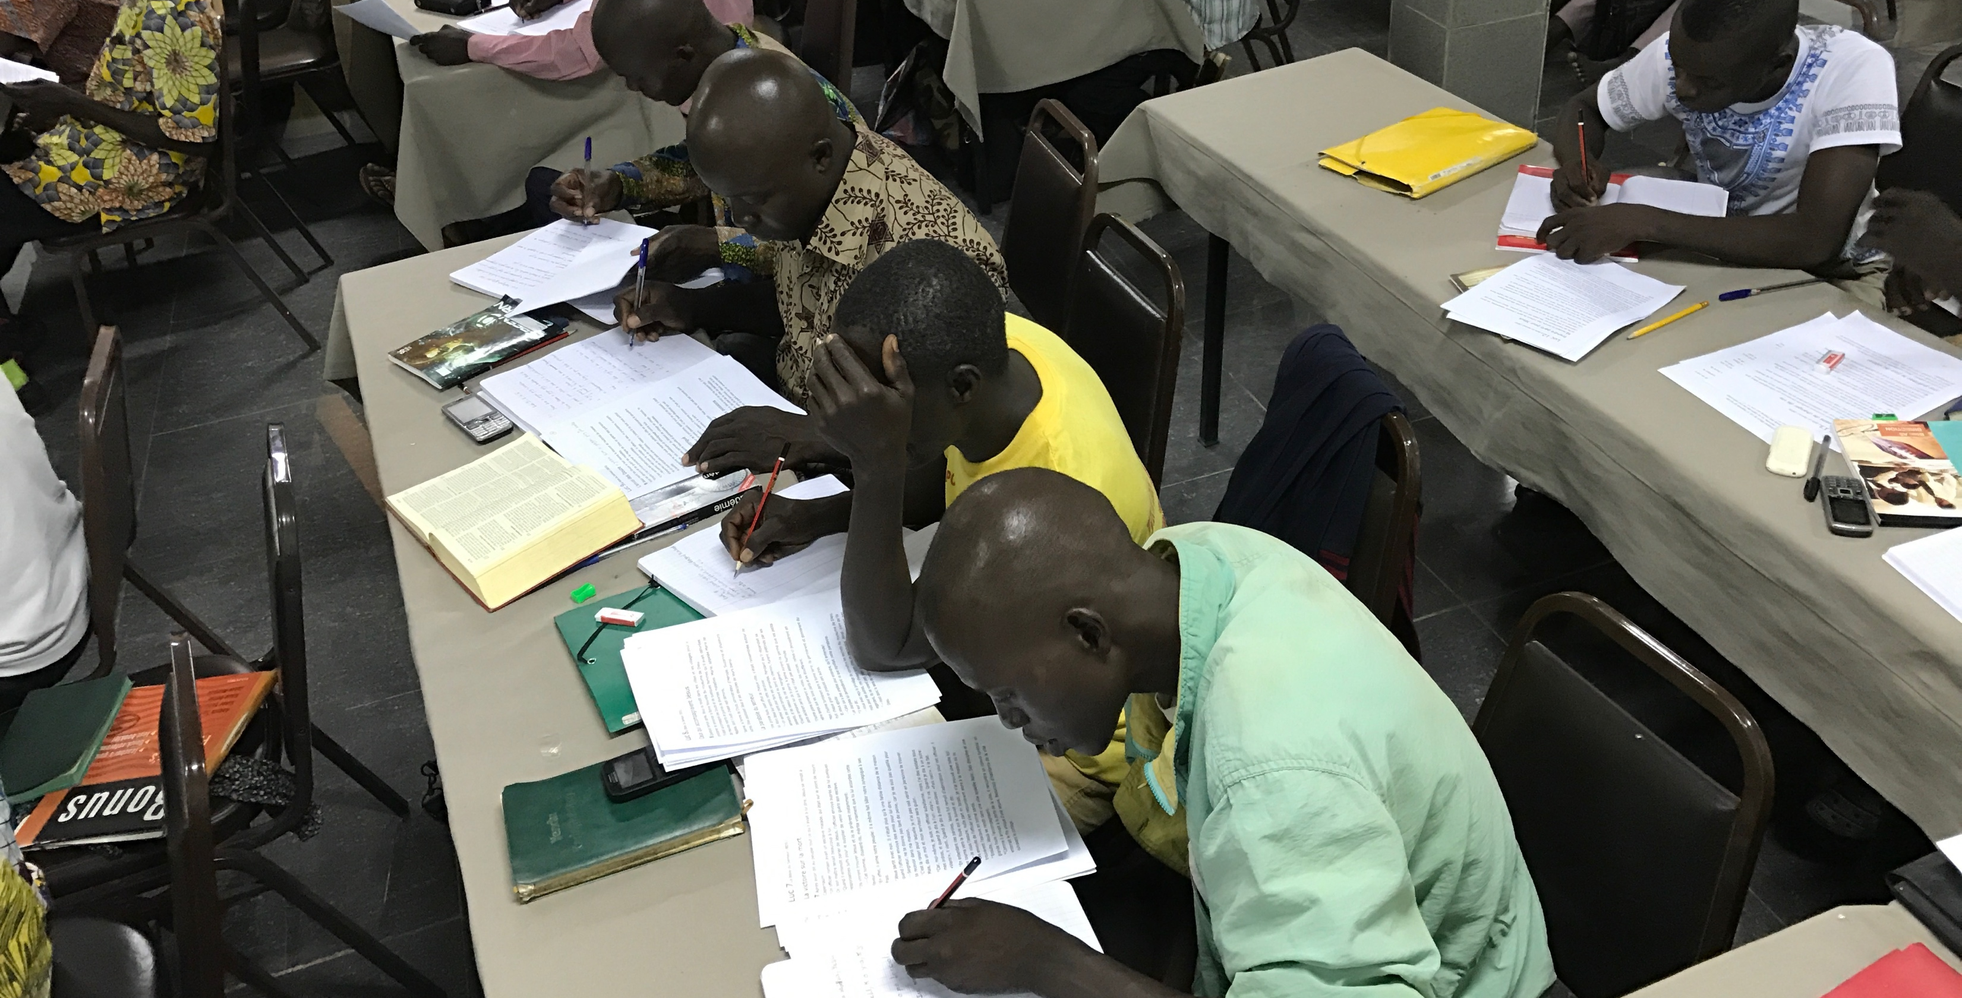
Church Owned Bible Translation
4 Beliefs

Slide 2
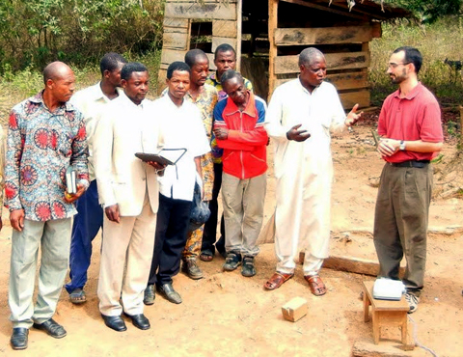
Ability
Authority
Responsibility
Local believers:
Know their language and culture
Have shared meaning through oral translation
Accountability

Slide 3
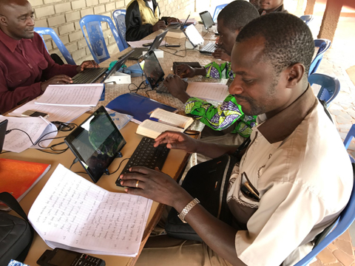
Ability
Authority
Responsibility
God’s Spirit gives the Local Church:
Authority
Wisdom
Accountability

Slide 4
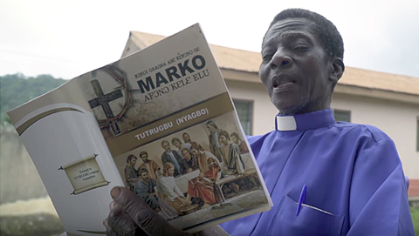
Ability
Authority
Responsibility
The Local Church is Responsible for:
Evangelism
Discipleship
Bible Translation
Accountability

Slide 5
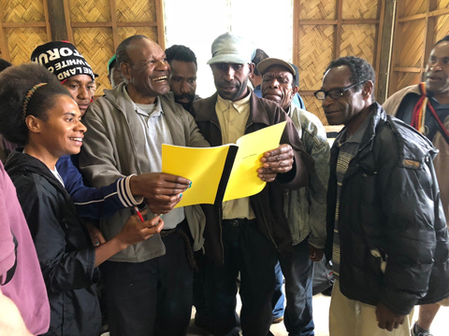
Ability
Authority
Responsibility
Translators are accountable to:
God
Their community
Accountability

Slide 6


